Slide 1


Deep Learning Sentiment Project
Product Reviews Sentiment Analysis
Karousos Ioannis - 2022202204017

Slide 2
1
3
Exploratory Analysis
Data Preprocessing
Table of Contents
2
4
VADER & BERT
Our Models

Slide 3

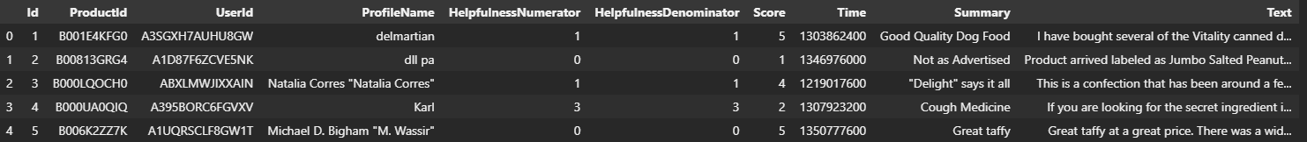
EDA
https://www.kaggle.com/datasets/snap/amazon-fine-food-reviews
10 columns
500K+ rows

Slide 4
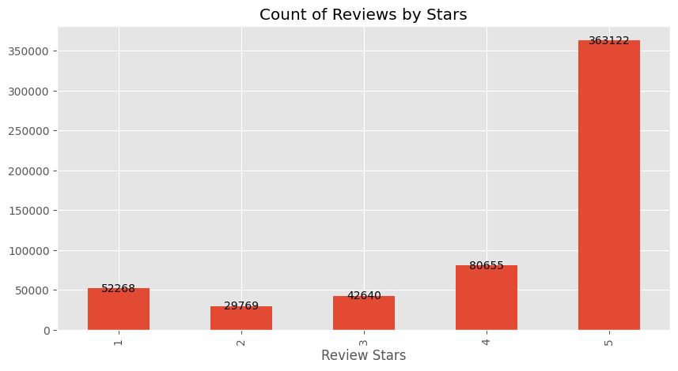
EDA

Slide 5
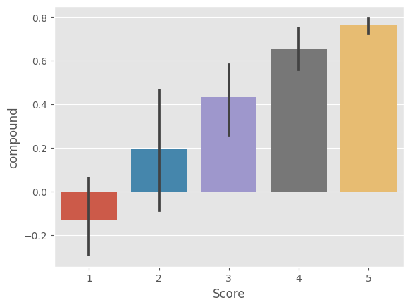
VADER
VADER - Bag of Words Approach
Negative Score < 0
Neutral Score = 0
Positive Score > 0
One notable drawback of VADER is its limited consideration of neighboring words or context when assigning sentiment scores.

Slide 6

RoBERTa
VADER - Bag of Words Approach
Negative Score < 0
Neutral Score = 0
Positive Score > 0
RoBERTa can use neighbor words for sentiment score!

Slide 7


Positive RoBERTa with 1-star review:
Examples
Positive VADER with 1-star review:
Negative VADER with 5-star review:

Slide 8
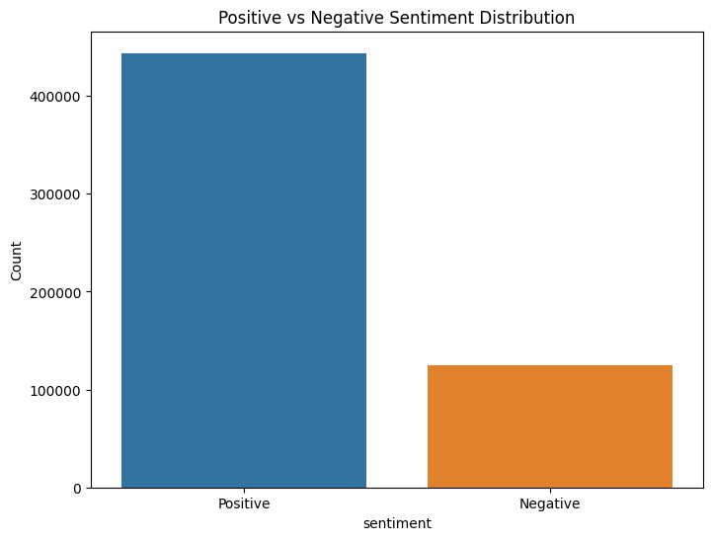
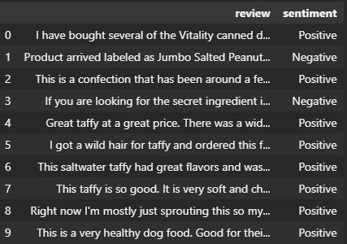
Data Preparation

Slide 9
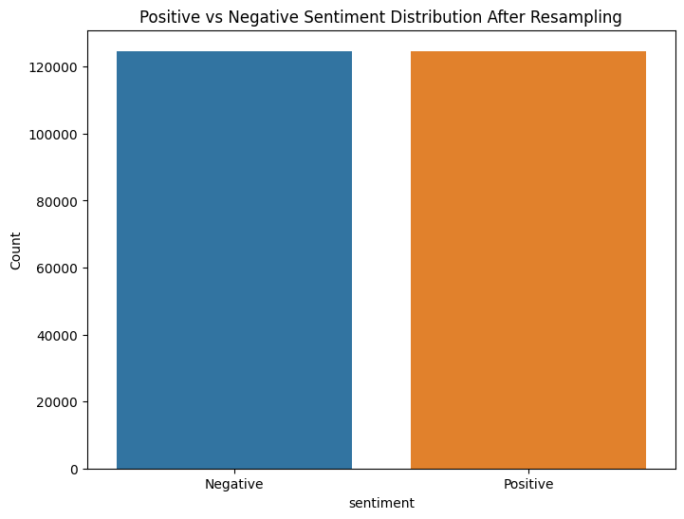
Under Sampling

Slide 10
Text Cleaning
Text to lowercase
Removing HTML tags
Removing punctuations and numbers
Removing single characters
Removing multiple spaces
Removing stopwords

Slide 11
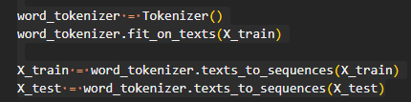

Splitting the Dataset
Converting text to numeric
X -> Reviews
Y -> Positive = 1
Negative = 0

Slide 12
GLOVE
Embeddings, transform words into dense and lower-dimensional vector representations.

Slide 13
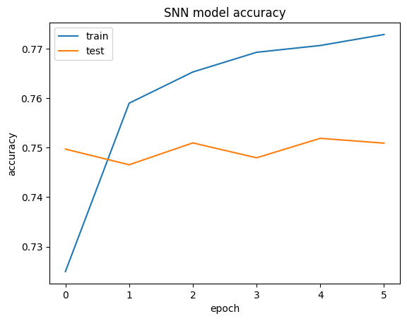
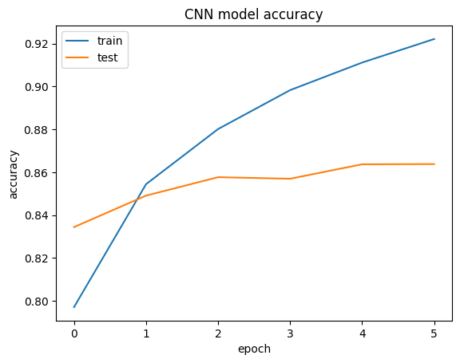
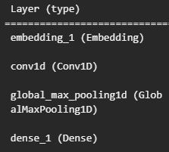
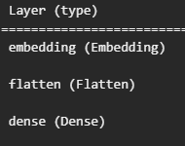


Our Models
Simple Neural Network
Convolutional Neural Network
batch_size=128
epochs=6
batch_size=128
epochs=6

Slide 14

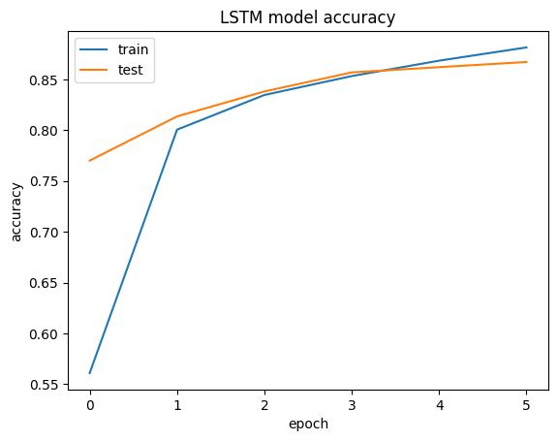
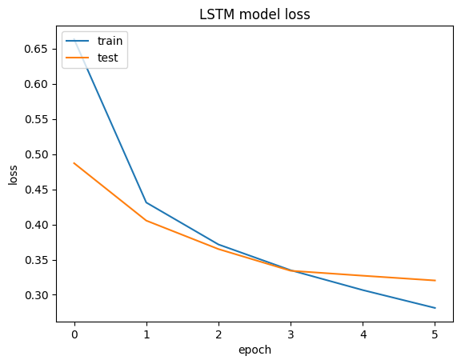
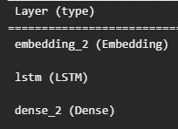
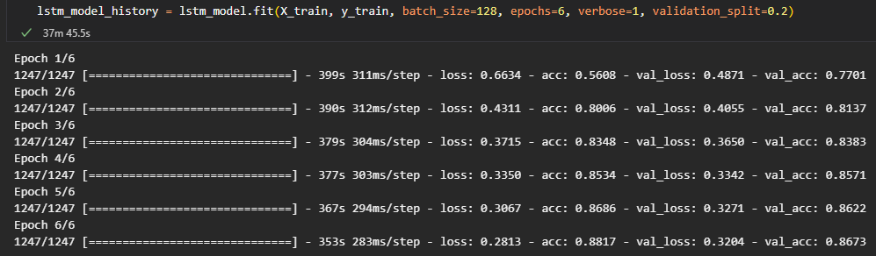
LSTM

Slide 15

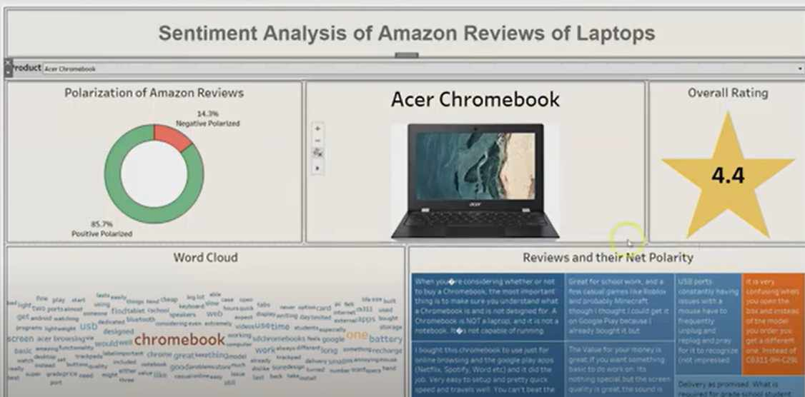
Future Scope
Hyper parameter Tuning.
Transfer Learning.
Production App.

Slide 16
Live Demo!

Slide 17

Thank You!

